Slide 1
Introduction to Phylogenomy:
Species tree – Genome tree
Fredj Tekaia
tekaia@pasteur.fr
Bioinformatics and Genome Analyses
Institut Pasteur Tunis, Tunisia. September 18 – December 15, 2017

Slide 2
The Phylogenomy aims at constructing species phylogenetic tree relating their evolutionary relationships.

Slide 3
Plan
• Introduction;
• Evolutionary processes;
• Homologs - Paralogs - Orthologs;
• Key features of phylogenetic trees;
• Gene tree - species tree;
• Multiple sequence alignment;
• Methods for Phylogenetic tree construction;
• Statistical evaluation of phylogenetic trees;
• Introduction to Phylogenomy;
• Introduction to Lateral Gene Transfer.

Slide 4
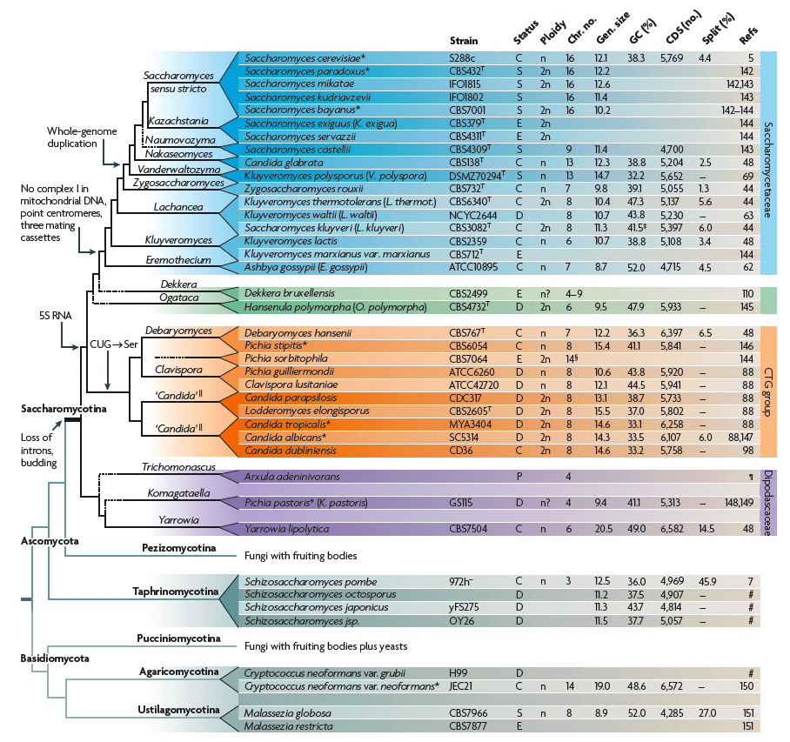
Yeast Genomics
Dujon (2010) Nature Rev. Genetics, 11: 512-524
Budding
yeasts
e
ca. 980 MYr
ca. 1,000 MYr
Fission
yeasts
ca. 1,100 MYr
Basidio
mycota
yeasts
Hedges et al., 2004 BMC Evol Biol. 4:2

Slide 5
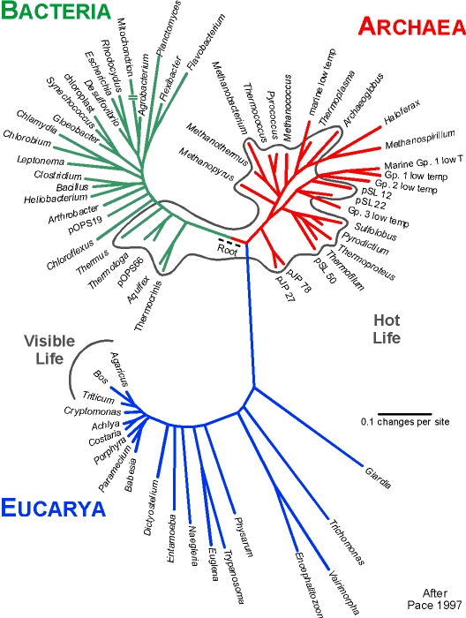
Pace (2001) described a tree
of life based on small subunit
rRNA sequences.
Pace, N. R. (1997) Science 276, 734-740
This tree shows the main
three branches described
by Woese and colleagues.
This tree is referred to as the tree of life or the universal tree.

Slide 6
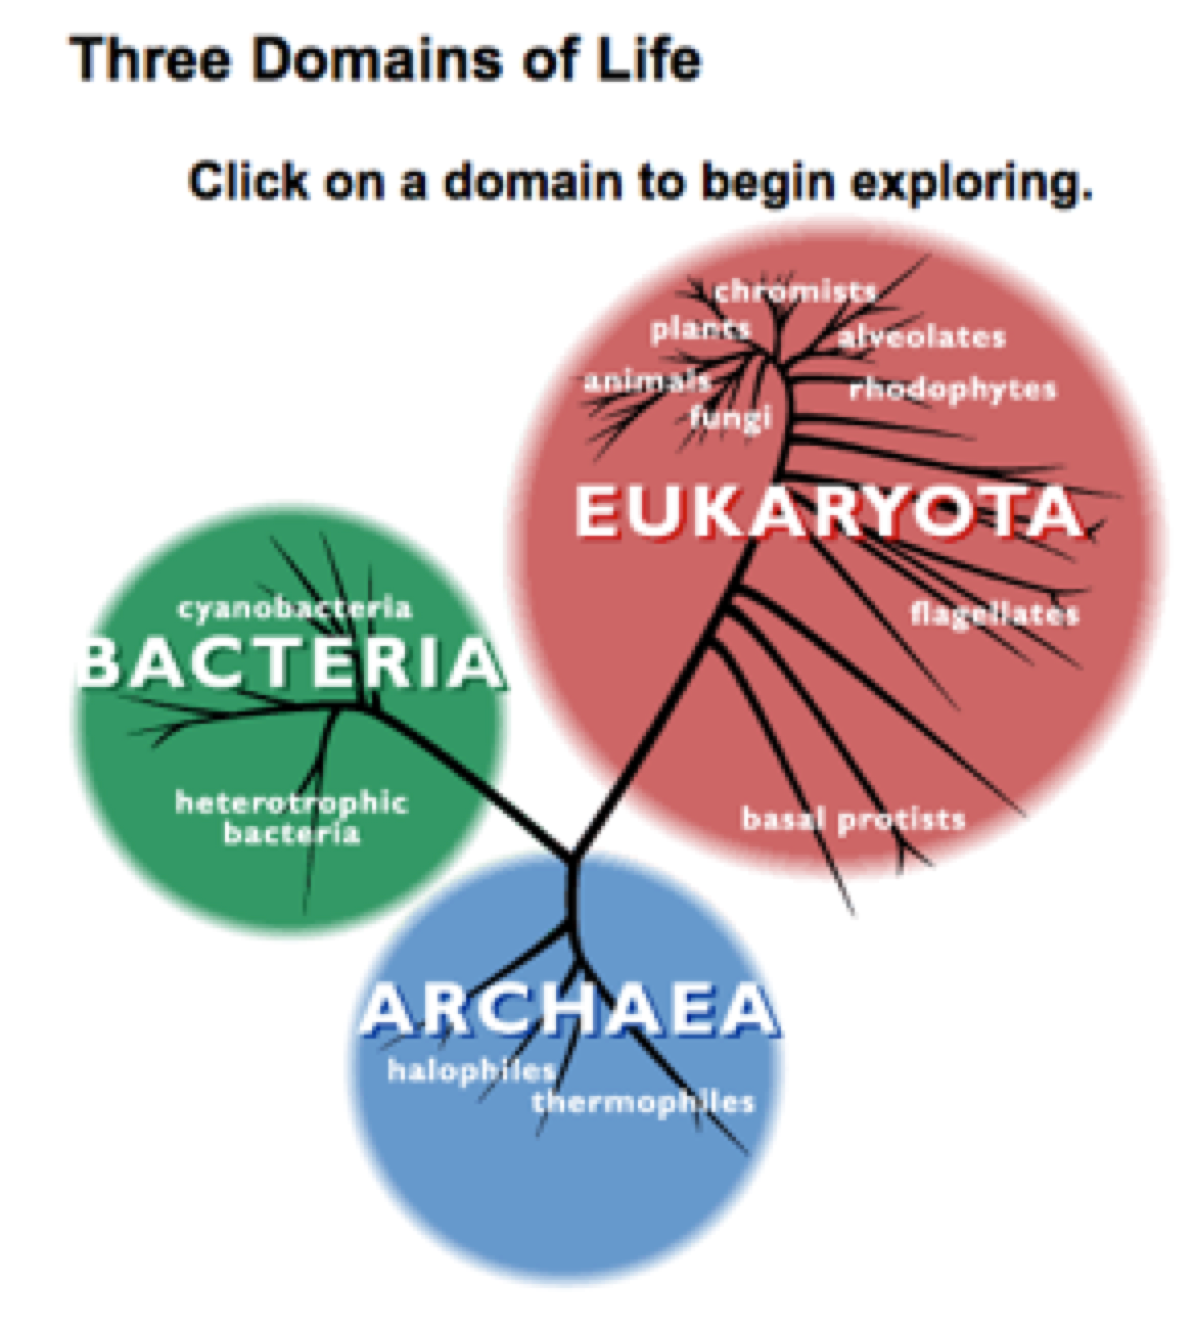
The Phylogeny of Life
http://www.ucmp.berkeley.edu/alllife/threedomains.html
The ancestor/descendant relationships which connect all organisms that have ever lived.

Slide 7
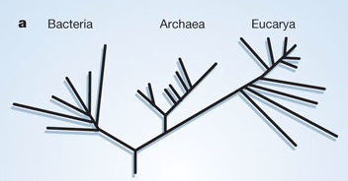
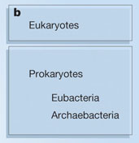
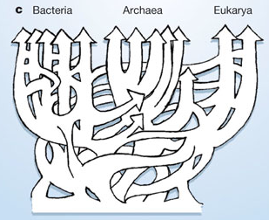
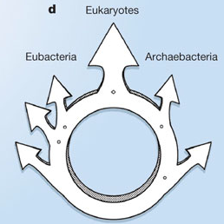
Martin & Embley
Nature 431:152-5.(2004)
The two-empire proposal, separating eukaryotes from prokaryotes and eubacteria from archaebacteria. Mayr, D. PNAS 95:9720-23. (1998).
The three-domain proposal based on the ribosomal RNA tree. Woese et al. PNAS. 87:4576-4579. (1990)
The ring of life, incorporating lateral gene transfer but preserving the prokaryote eukaryote divide.
Rivera & Lake JA. Nature 431: 152-5. (2004)
The three-domain proposal, with continuous lateral gene transfer among domains.
Doolittle. Science 284:2124-8. (1999)

Slide 8
Introduction to Phylogenomy:
Species phylogeny
• Consider the alignment of the concatenation of many orthologous genes and proceed to phylogenetic tree construction
• Consider matrices that include phylogenetic information related shared orthologous genes:
- number of shared orthologs;
mean genetic distance of shared orthologs;
-……

Slide 9
Problems with species tree construction
• Main difficulties in species tree construction include extensive incongruence between alternative phylogenies generated from single-gene data sets;
• Genes don't evolve at the same rate or in the same way, the evolutionary history inferred from one gene, say for rRNA, may be different from what another gene appears to show.

Slide 10
Introduction to Phylogenomy
• Species tree construction;
• The phylogeny of single genes may be different from the phylogeny of their corresponding species;
• Idea of considering many genes instead of only one gene to estimate species phylogeny;
• Concatenation of the set of genes common to the considered species;
• Estimate species phylogeny from the concatenated genes;
• Some difficulties related to this procedure.

Slide 11
• Phylogenomic tree
(based on concatenation of a gene sample common to the considered species)
S₁
.
.
S_{n}
Difficulties:
• genes don't evolve at the same rate nor in the same way;
• a limited number of genes are shared among all species;
Dagan and Martin (2006). The tree of one percent. Genome Biology, 7:118.

Slide 12
These methods suffer difficulties related to the phylogenetic tree construction:
• global sequence alignment (quality, gaps,...);
• substitution variations between genes;
• different evolutionary histories of genes;
• substitution saturation;...
Alternative proposals : genome trees

Slide 13
Genome Trees
A tree tracing the evolutionary history of species based on :
• their overall similarities (as deduced from pair-wise whole proteome comparisons);
• their pair-wise shared orthologous genes;
• on conservation profiles of shared orthologs;
• ….

Slide 14
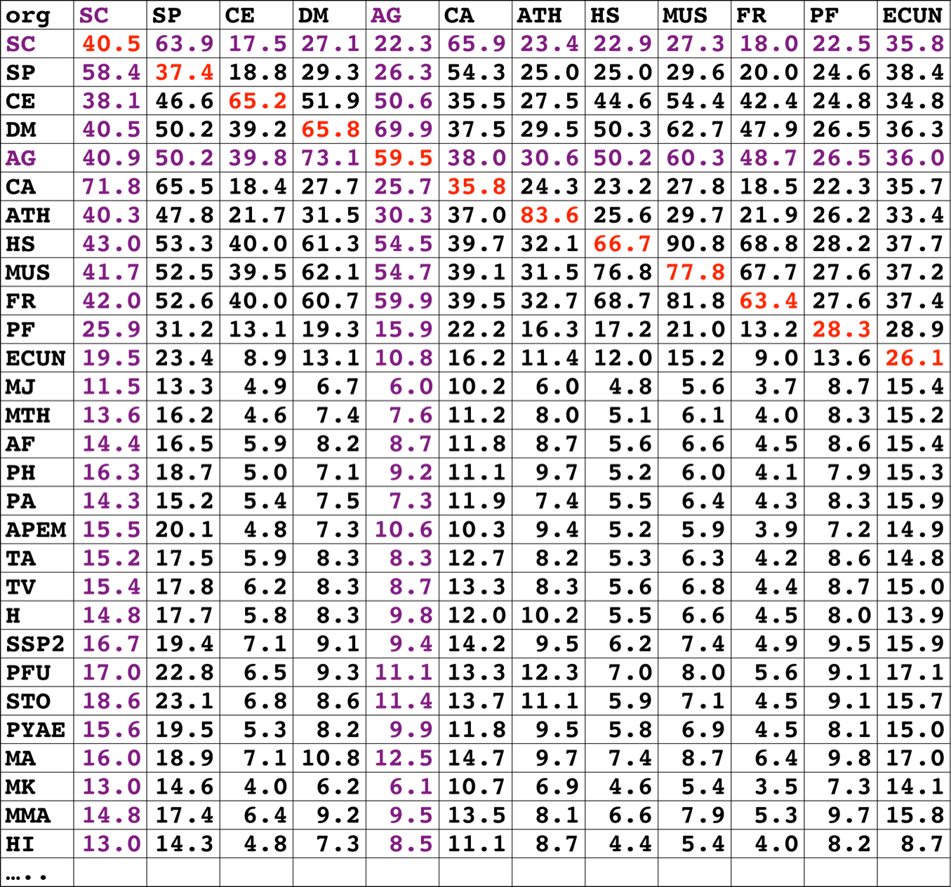
Ancestral duplication and ancestral conservation
W_{ij}
• genome similarity
• shared orthologs

Slide 15
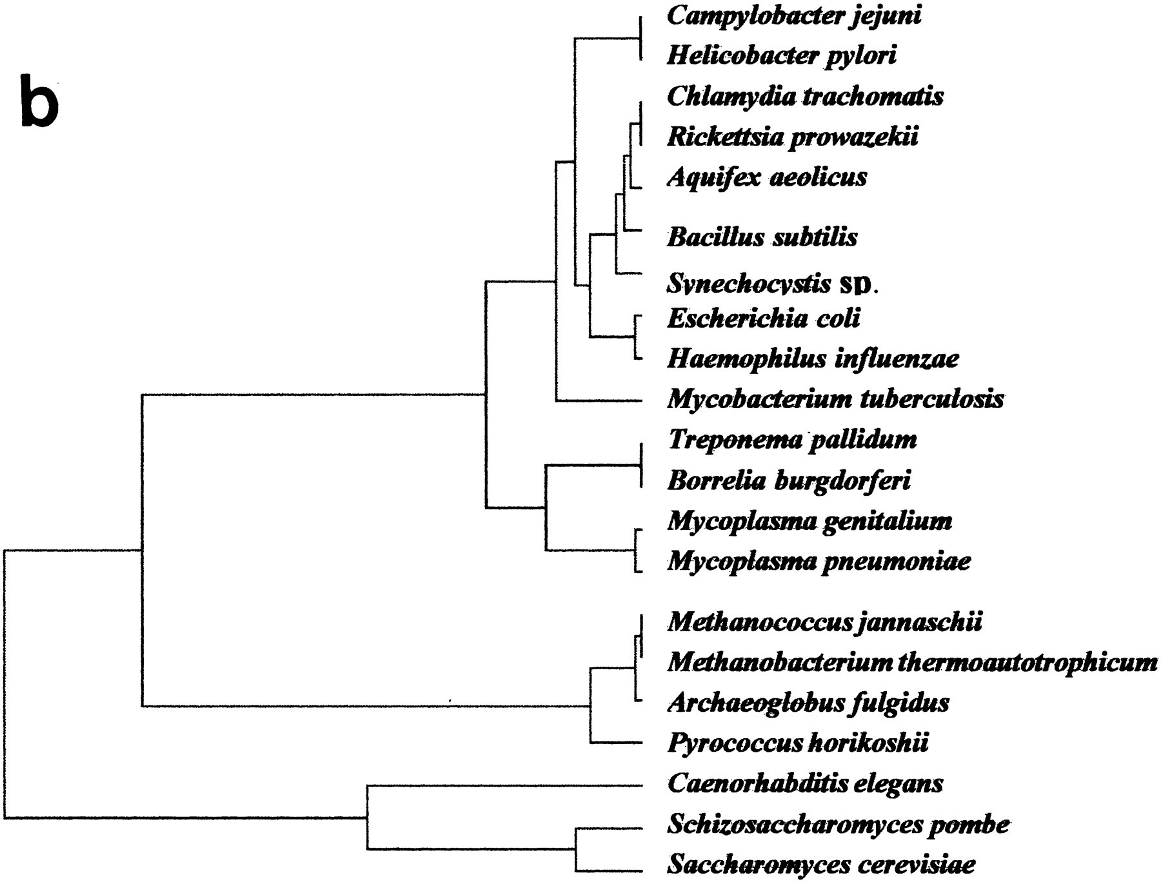
Tekaia, Lazcano & Dujon (1999)
Genome Research 9: 550-7.
B
A
E

Slide 16
Conservation profiles
• 99 species (B: 33; A: 19; E:27); 541880 proteins
p 0111111000111111111000110110111101001111101111
• A “conservation profile” is an n-component binary vector describing a protein conservation pattern across n species.
Components are 0 and 1, following absence or presence of homologs.
Main interesting properties of conservation profiles:
• Conservation profiles are signatures of evolutionary relationships;
• A conservation profile is the trace of protein evolutionary histories jointly captured in a set of n species (multidimensional feature);
Tekaia F, Yeramian E. (2005). PLoS Comput Biol.1(7):e75

Slide 17
Protein conservation profiles
E A B
S₁..............I.............I................S_{n}
G_{1,1} 100000000000000000000000000000000000000000000000
G_{2,1} 111111111111111111111111111111111111111111111111
G_{3,1} 111111110011111111111111011101110101111111101111
.......................................................
G_{n1,1} 100001110001000000000000000000000000000000000000
G_{1,2} 010000000000000000010100000000000111000011100011
G_{2,2} 010000000000000000010100000000000111000011100011
........................................................
G_{n2,2} 111111110011111111111111011101110101111111101111
........................................................
G_{1,n} 011110100000000000000000001000000000000000000001
G_{2,n} 111111110011111111100011011101110101111111101111
G_{3,n} 111111110011111111100011011101110101111111101111
........................................................
G_{np,n} 100110000000000000000000000000000000000000000001
Table : 541880 proteins x 99 species

Slide 18
Protein conservation profiles
• Different conservation profiles represent different evolutionary histories
541880 proteins x 99 species
184130 distinct conservation profiles

Slide 19
Genome trees: data matrices
T = {T_{ij} ; i=1,n; j=1,n; n is the number of surveyed species}
T_{ij} is the overall similarity score between species j and i: conservation; shared orthologs,...
• Jaccard similarity scores
{ s_{ij} = N₁₁/(N₁₁+N₀₁+N₁₀); }
{s_{ij} = (Jaccard similarity score between species i and j) }
T = { T_{ij} = 100*s_{ij} ; i=1,n; j=1,n}
184130 distinct conservation profiles

Slide 20
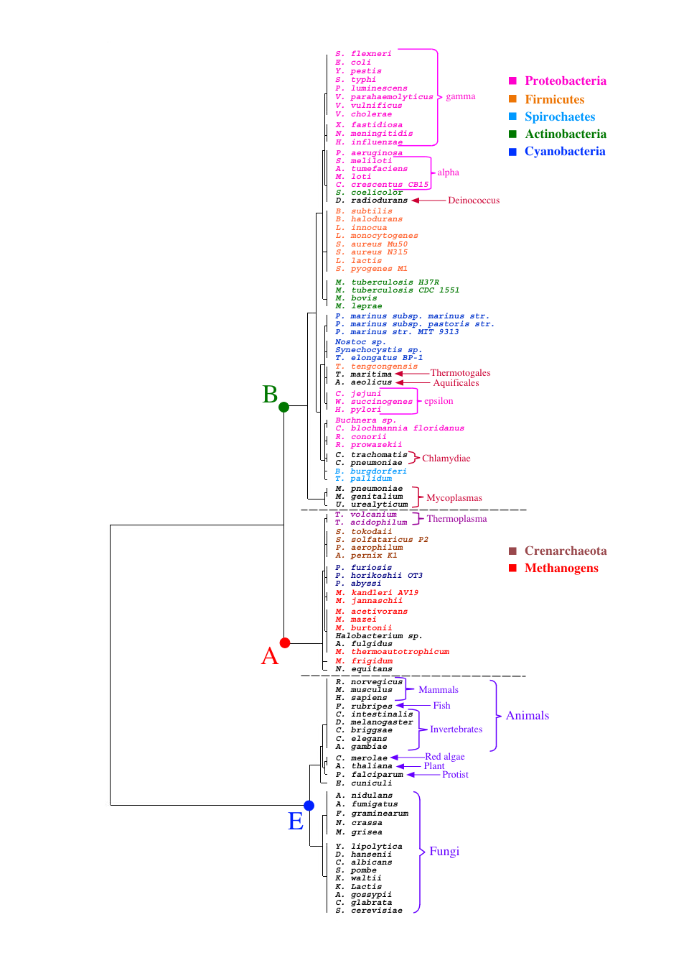
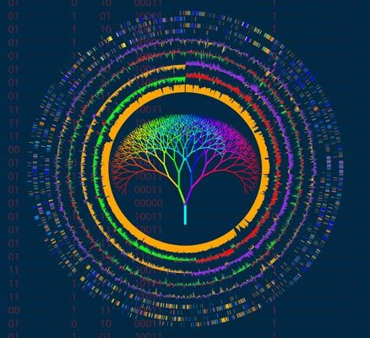
profiles tree
Tekaia F, Yeramian E. (2005).
PLoS Comput Biol.1(7):e75

Slide 21
Horizontal/Lateral Gene Transfer (HGT/LGT)

Slide 22
Horizontal/Lateral Gene Transfer (HGT/LGT)
• Genome comparisons (particularly bacterial) show that during evolution a significant number of genes were laterally transferred from one species to another;
• Tranferred genes are very difficult to detect such?

Slide 23
Lateral gene transfer and the nature of bacterial innovation
Howard Ochman, Jeffrey G. Lawrence and Eduardo A. Groisman (2000)
Nature 405, 299-304.
Unlike eukaryotes, which evolve principally through the modification of existing genetic information, bacteria have obtained a significant proportion of their genetic diversity through the acquisition of sequences from distantly related organisms. Horizontal gene transfer produces extremely dynamic genomes in which substantial amounts of DNA are introduced into and deleted from the chromosome.
These lateral transfers have effectively changed the ecological and pathogenic character of bacterial species.

Slide 24
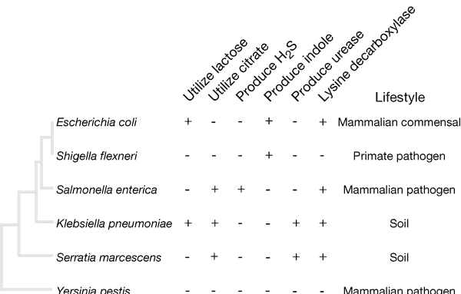
Plus denotes the presence and minus the absence of a trait in more than 85% of strains. Evolutionary relationships among species are based on nucleotide sequence information. In many cases, genes acquired by horizontal transfer confer the species-specific traits.

Slide 25
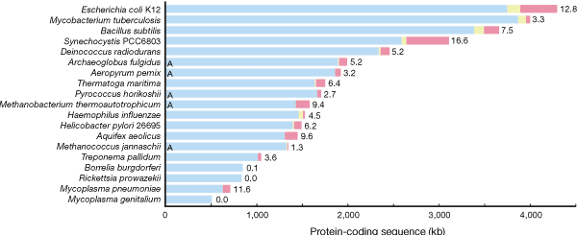
Lengths of bars denote the amount of protein-coding DNA. For each bar, the native DNA is blue; foreign DNA identifiable as mobile elements, including transposons and bacteriophages, is yellow, and other foreign DNA is red. The percentage of foreign DNA is noted to the right of each bar. 'A' denotes an Archaeal genome.

Slide 26
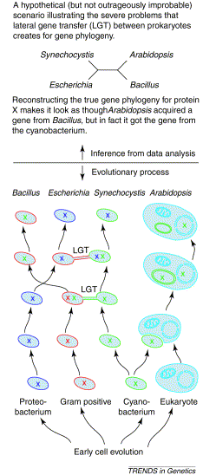
Lateral gene transfer - what a problem for phylogenetics! How lateral gene transfer between prokaryotes subsequent to the origins of organelles can lead to erroneous inferences of eukaryotic gene origins. In the lower panel, a case of lateral gene transfer (LGT) is depicted as described in the text. The mechanism of LGT sketched here is intended to mean conjugation, but many mechanisms of lateral gene transfer are known and for the purposes of the figure, the mechanism is irrelevant. In the upper panel, the tree that would be constructed from those sequences is shown - although the plant obtained its gene from a cyanobacterium, LGT makes it look as though it came from Bacillus. As outlined in the text, there is a fine line that separates inferences drawn from phylogenetic data analysis and the evolutionary process itself. Pinning down the role of lateral gene transfer is a very tough problem.
Rujan & Martin: Trends Genet 2001 Mar;17(3):113-20.

Slide 27
Evolution by Domains/Motifs
Using MEME/MAST programs

Slide 28
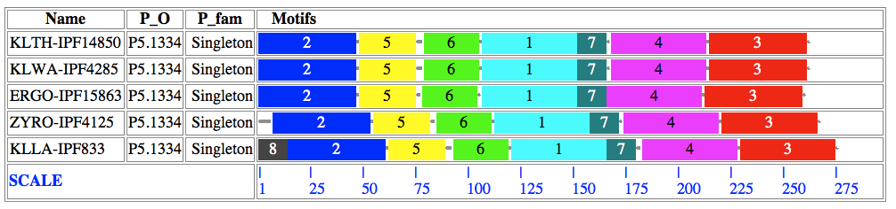
Simple case: SPO5.11

Slide 29
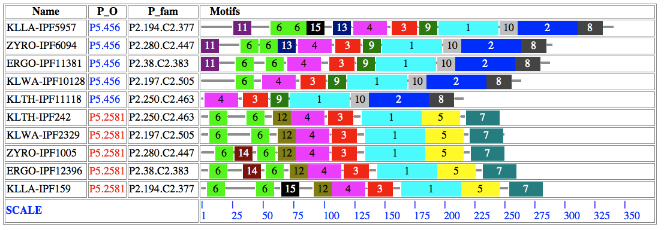
11 6 6
SPO10.135
Expansion
ancestor?
Degradation/
Expansion
12
5
7
6 6

Slide 30
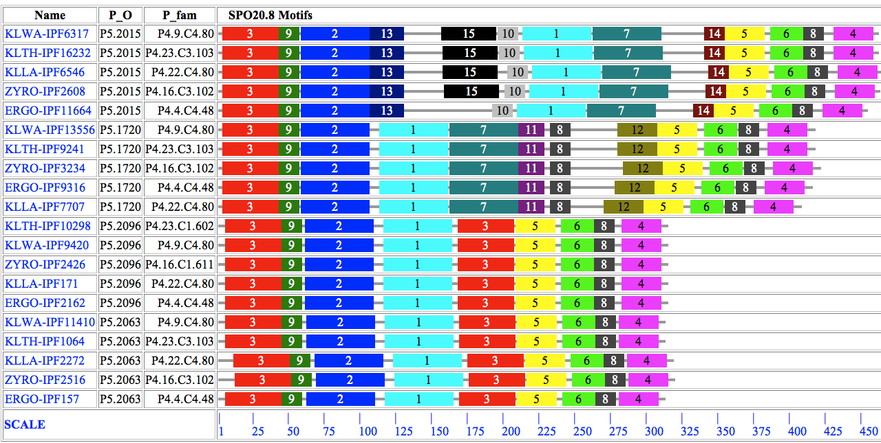
P5.2096
P5.2063
3, 9, 2, 1
5, 6, 8, 4
ancestral part?

Slide 31
References
• Phylogeny programs :
http://evolution.genetics.washington.edu/phylip/software.html
• MEGA: http://www.megasoftware.net/
• PAML: http://abacus.gene.ucl.ac.uk/software/paml.html
Books:
• Fundamental concepts of Bioinformatics.
Dan E. Krane and Michael L. Raymer
• Genomes 2 edition. T.A. Brown
• Molecular Evolution; A phylogenetic Approach
Page, RDM and Holmes, EC
Blackwell Science

Slide 32
Thank You

